Slide 1
Application Controller Pattern
cit360

Slide 2
What is Application Controller Pattern
The ACP is a sub pattern required in the Web/App for implementations. This controller is placed in between the controllers that are related to HTTP, in association with the remaining MVC files which is part of the application.

Slide 3
Importance
The application controller is responsible for taking care of business logic and does not intrude into the responsibilities of the domain model. For every user interaction, the web application is in a specific state.

Slide 4
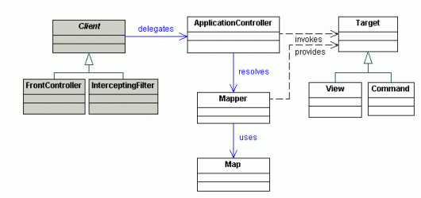
structure of the application controller

Slide 5
Explanation
The structure of the application controller is such that it connects the intercepting filter, front controller, mapper, map, and target. All of these objects are centralized by the application controller. The client gets responses from the intercepting filter and the front controller. It then delegates it further to the application controller. The application controller sends the request to the mapper which further sends it to the map object. The application controller invokes the target while the mapper provides the target. The application controller pattern is used to cater many different issues and it gives the benefit of improved reusability, modularity, and extensibility.

Slide 6
CODES
DEMONSTRATION…………………………………………………….

